Slide 1
Master Chef
By: Enoch Johnson, Caleb Baldinelli, and Ben Selders

Slide 2
Brainstorming Idea
Self-cleaning shower/toilet
Molding chair for school/car seats
Vision correction program
Better/More comfortable school buses
Double-sided pan
Shower that dries user
Self-organizing pantry
Odor-resistant socks
Socks that stay clean
Spray on shoes
Fireproof building
Naturally air conditioned clothes
Easy weight loss
Coolsculpting for home
Disposable water bottles
Uprising nicotine/vape “Cure”
Fire-resistant siding made of fire-resistant wood
Hail-proof cars
Engines that can contain explosions
Cutting boards that clean themselves
Nasal Vacuum
Skeleton Key for mechanical locks
Phone case which molds to the user’s grip
Phone charger that automatically shuts down when the phone reaches 100%
Computer cursor which moves wherever you look
Water bottle that boils water
Glasses with zoom
Socks that fit all sizes
Alternative uses for fecal matter
Universal charger
Charger which utilizes ESD
Life skills education
Fast stimulating product that gives the user a boost through sensory reactions
Drug which activates the body’s flight or fight response for energy
Ad screens in bathrooms

Slide 3
Problem Statement
50.4% of youth surveyed said they eat fast food 1 to 2 times a week. 42.6% of youth surveyed said they have beginner cooking skills. The dependence on fast-food, restaurants, and pre-cooked meals is increasing due to the decline of cooking skills in Americans between 14 and 21 year olds.

Slide 4
Statement of Purpose
To increase the knowledge and array of cooking skills of youth and young adults in America.

Slide 5
Survey Questions/Justification
What is your gender?
What ethnicity do you identify?
How many people live in your home?
What is your household's approximate combined income?
Are you a high school student?
If you are in high school, what is your current grade level?

Slide 6
Survey Questions/Justification
What is the highest level of education you have completed?
How often do you prepare a meal from scratch (No microwavable foods, frozen dinners, premade canned meals, ex: SpahettiOs)?
How many times a week do you consume fresh meats, vegetables, and fruits in your meals?
How many days a week do you eat at a restaurant or fast food joint for a meal?
How many times a week do you use Blue Apron or a service like it?

Slide 7
Survey Questions/Justification
How often do you consume instantly made food (Microwavable foods, frozen dinners, premade canned meals)?
Is your diet impacted by religious/health reasons?
What do you value most when purchasing food?
How much do you value cooking as a skill?
Do you consider yourself a beginner, intermediate, or expert cook (cooking with fresh ingredients to create a full meal)?

Slide 8
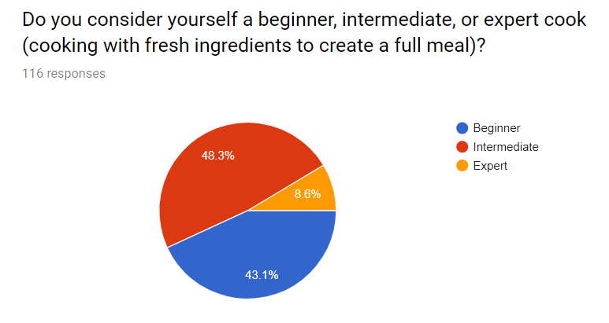
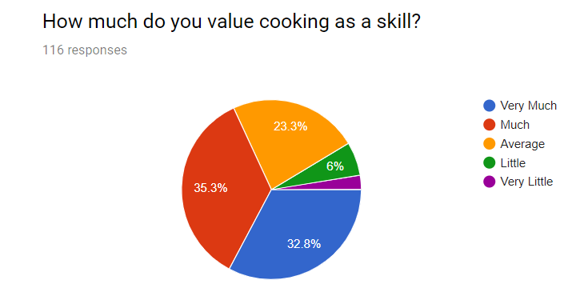
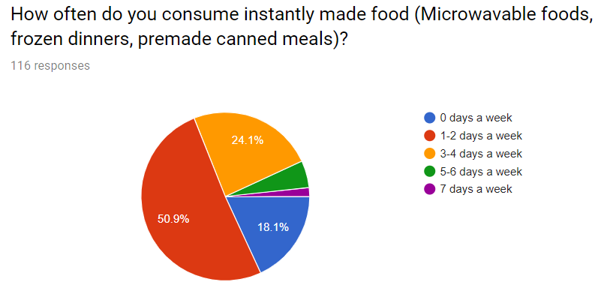
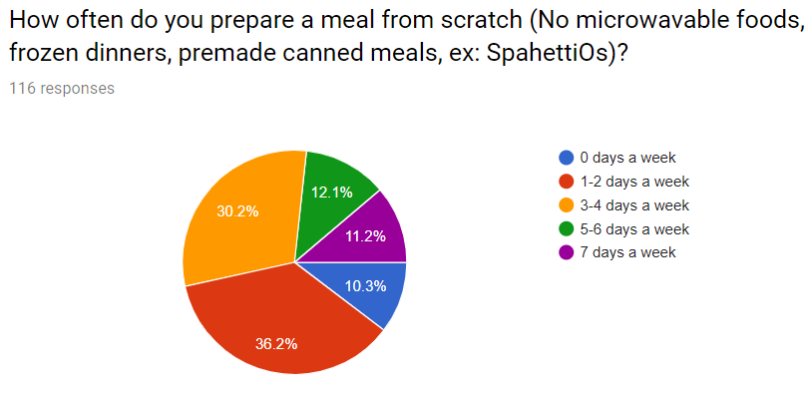
Pre Survey Data/Justification

Slide 9
Criteria and Constraints
Criteria
-Must be Educational
-Must be User-Friendly
-Must be Cooking-Related
-Must be High-Quality
-Must be Engaging for the User
Constraints
-Timeframe of the Project
-Limited Experience in Cooking
-Limited Experience in Programming
-Lack of Economic Capital
-Limited Personnel

Slide 10
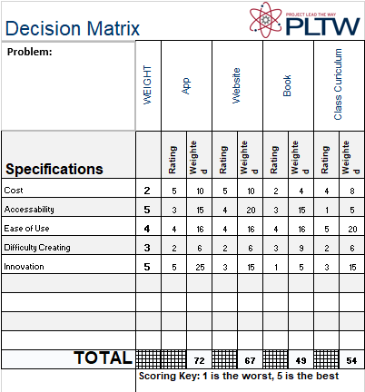

Slide 11
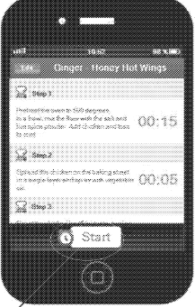
Patents
These patents relate to cooking education products and techniques
Patent Number:EP2649594B1
Patent Number:CA2304020C
Patent Number:EP2989747B1
Patent Number:US3292525A
Patent Number:US3217634A
Patent Number:AU2003274896B2
Patent Number:US6270351B1
Patent Number:US5306154A
Patent Number:RU2442222C2

Slide 12
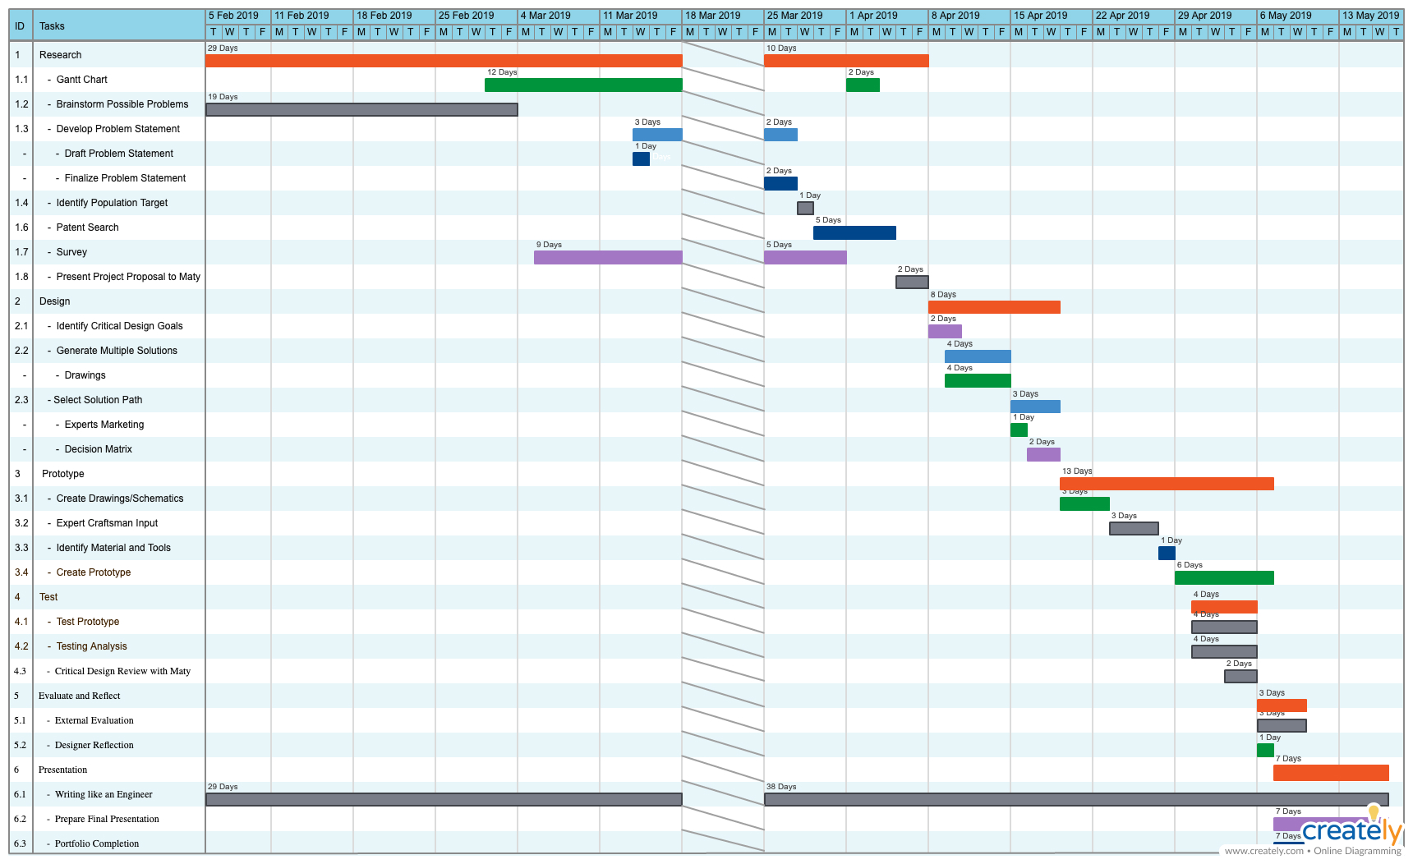
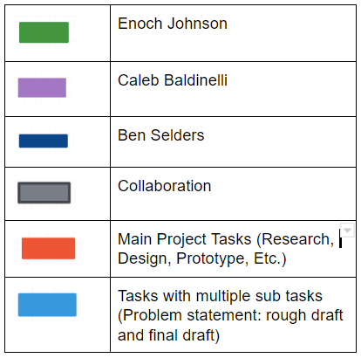
Gantt Chart

Slide 13
Design Specifications
We created an app that gives users the opportunity to learn the basics of cooking through written instructions, pictures, and videos. They can then use what they learned to make more advance recipes that are also taught in the app via picture, instruction and videos.

Slide 14
Materials & Vendors
XCode (Apple)
Mac (Johnson Amalanathan)
Cooking and filming area (Amy Baldinelli)

Slide 15
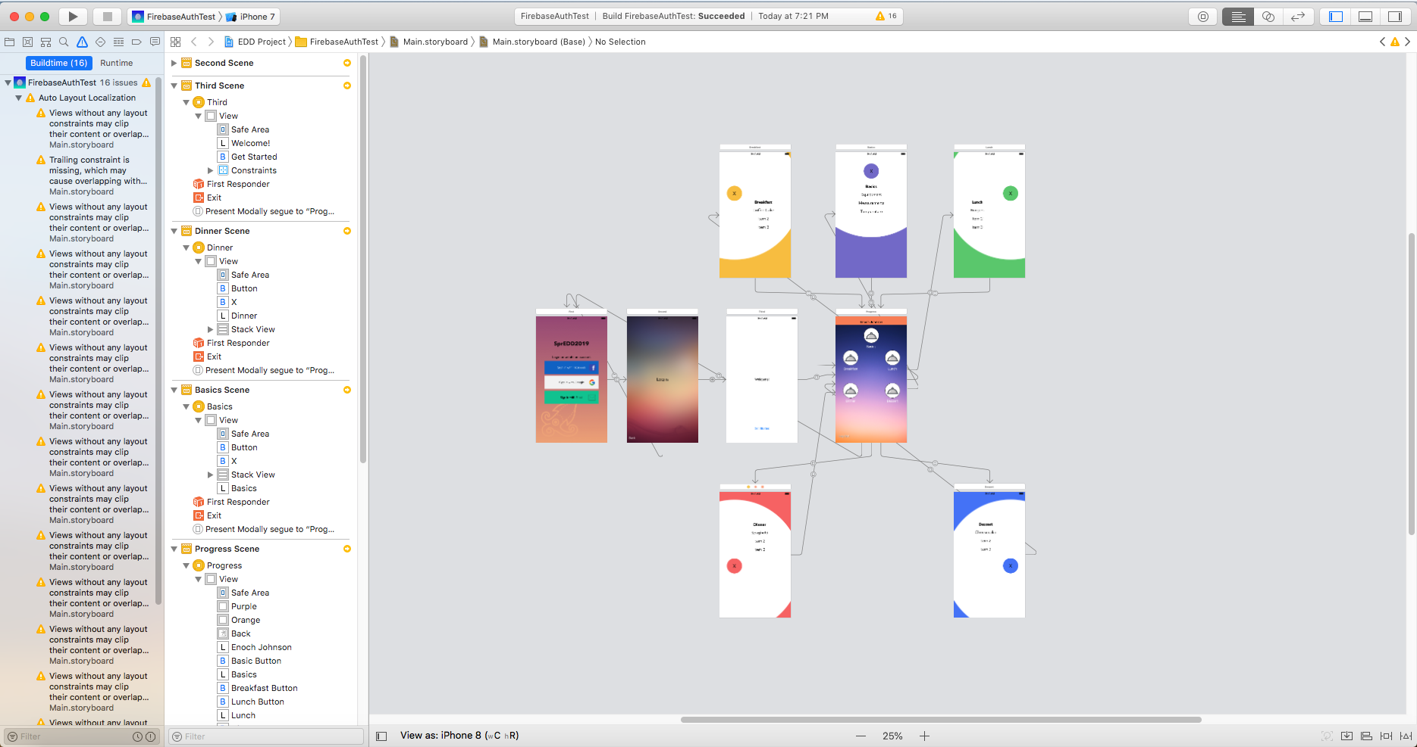
Design Process
We built our app using Xcode app developer and created all of the content originally. We filmed the videos and pictures on a 4k 20.6 Megapixels Still Image Recording Camera

Slide 16
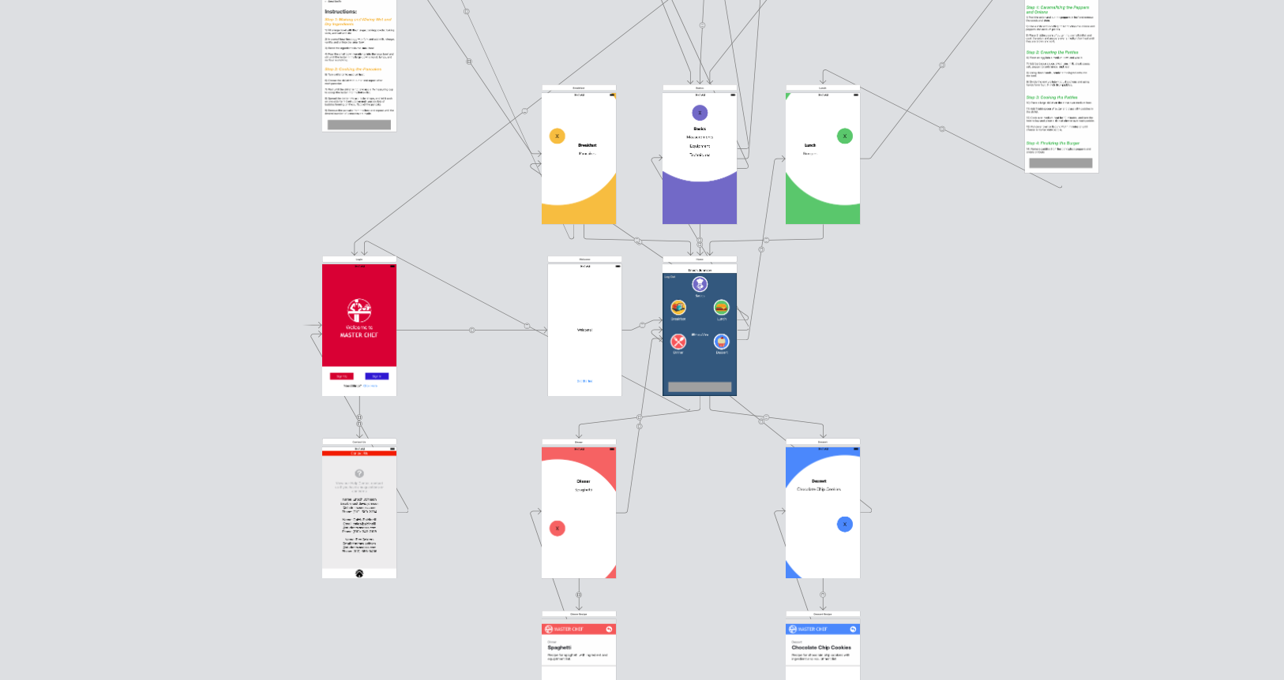
Diagrams and Flowcharts

Slide 17
Old Design

Slide 18
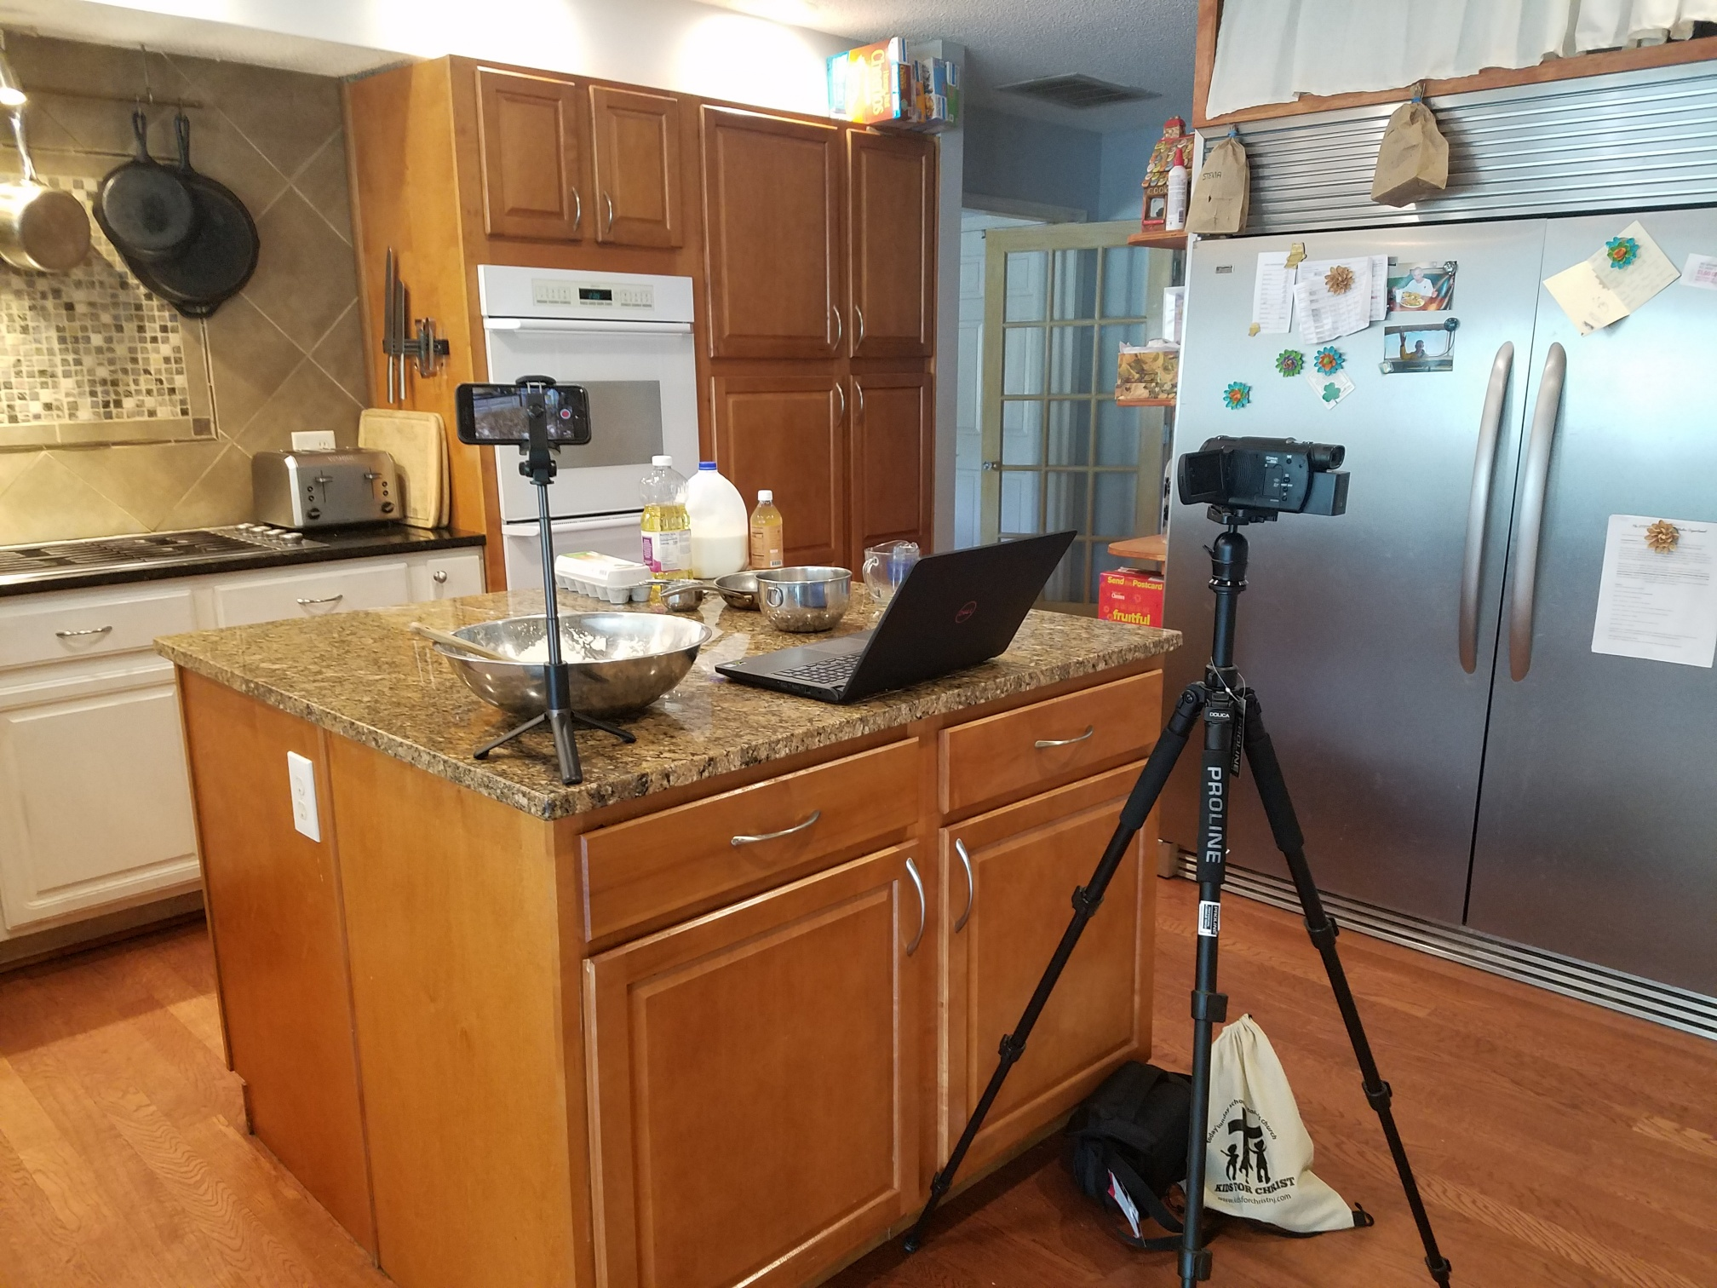
Filming
We spent 7 hours filming videos for the Basics, Breakfast, Lunch, and Dinner sections of our app in order to provide the users multiple ways to learn recipes and technique.

Slide 19
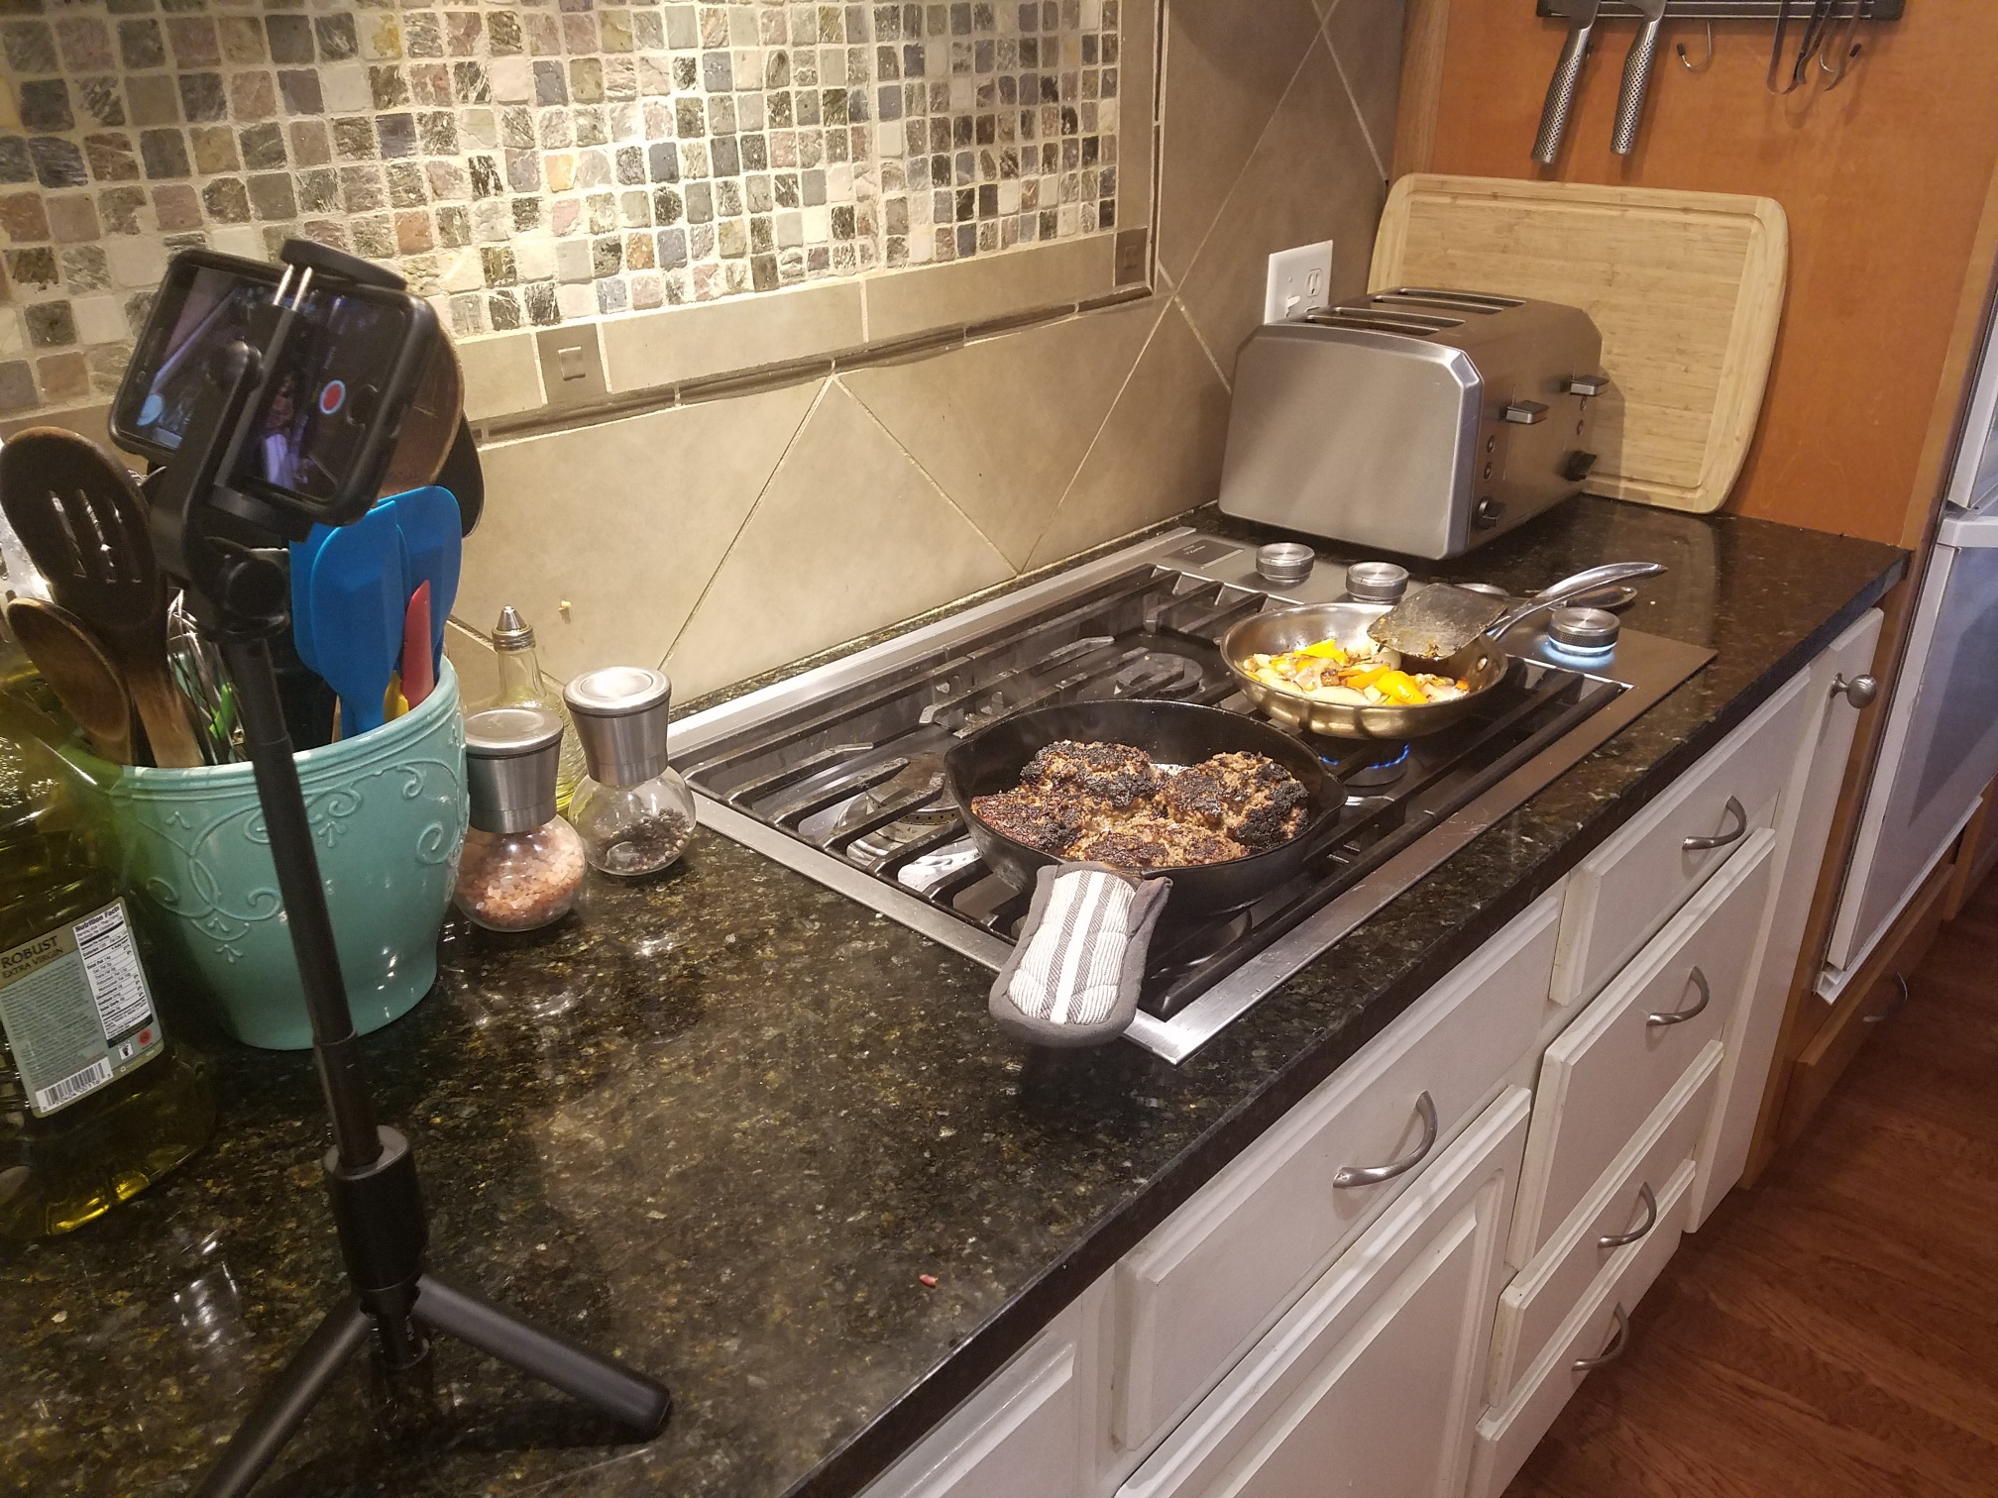
Filming

Slide 20
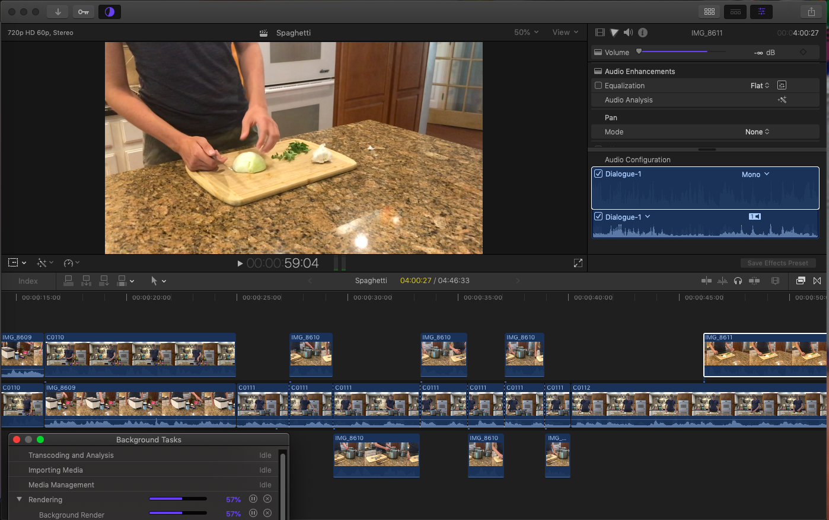
Editing

Slide 21
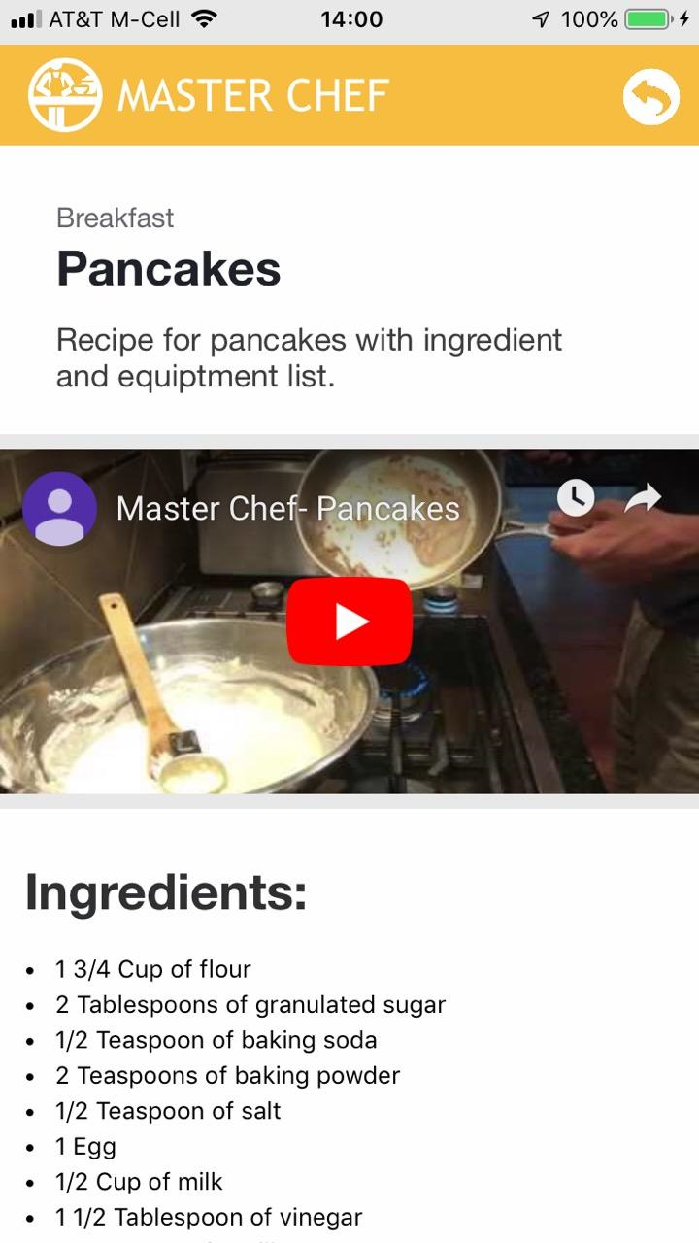
Content
The recipes, technique, and information used in our app was based off of our knowledge and based from collective cooking fundamentals.

Slide 22
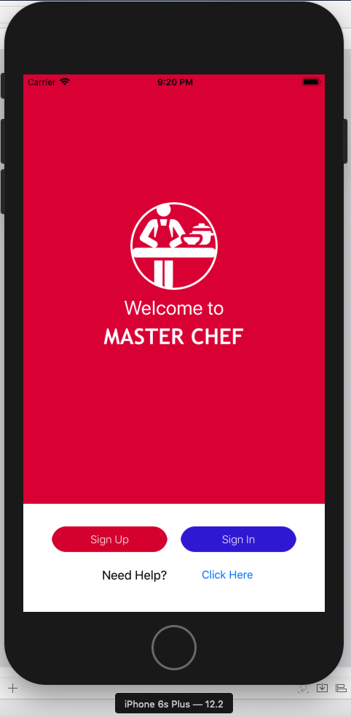
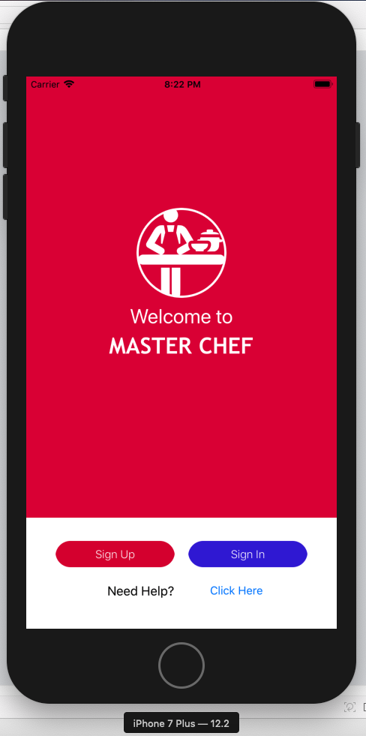
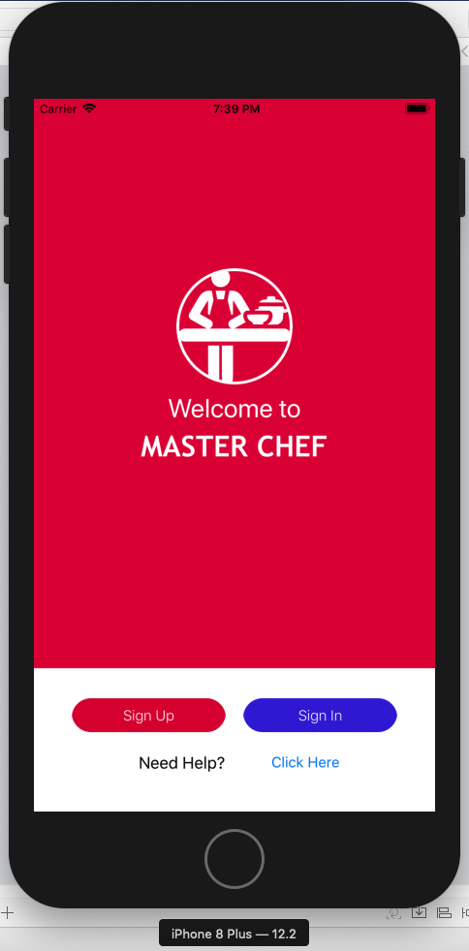
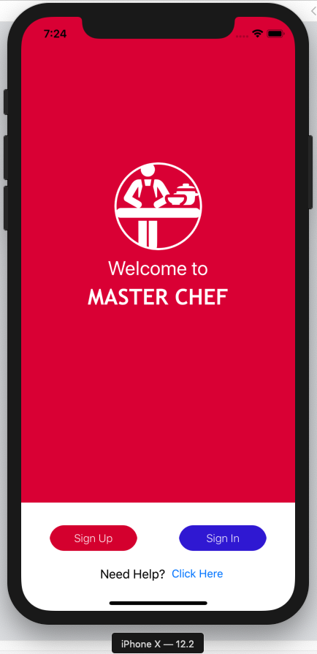
App

Slide 23
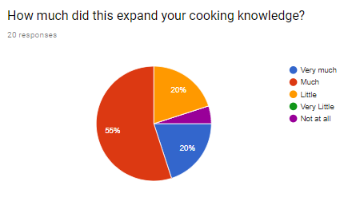
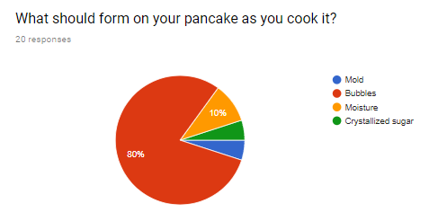
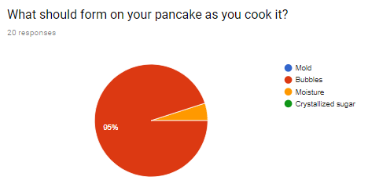
Test Results
“The overall design of the page was great. I liked how everything was organized and easy to access and understand.”
“The app was really well organized and informational, the graphics and content were good.”
“Very helpful! Pancakes recipe should be somehow shortened, too much reading for my eyes!”

Slide 24
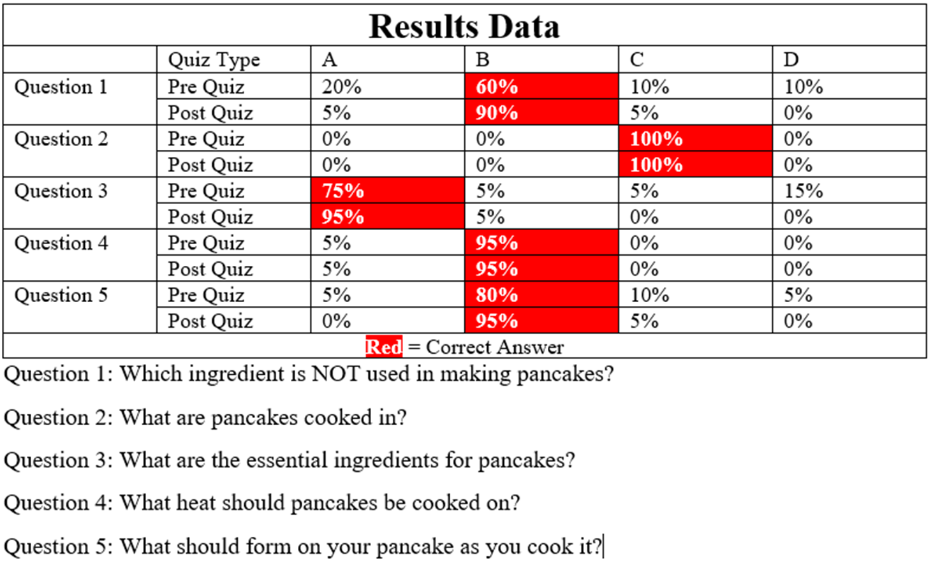
Results

Slide 25
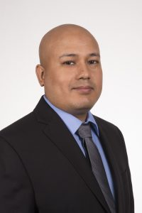

Experts
Dr. Chanchal Tamrakar
Dr. Y. Daniel Liang
Ph.D. (Marketing)
MBA (Marketing specialization)
MBA (Marketing focus)
Ph.D. Computer Science
M.S. Computer Science
B.S. Computer Science

Slide 26
Business Plan
Ads will be in banner form and pop-up form, with the ads generating $0.20-$2.00 per view and from $3.00-$5.00 per click
The app will have a premium variant which is ad-free, which will be available for those who subscribe and pay a subscription of $1.99.

Slide 27
Improvements
More recipes added to the Breakfast, Lunch, Dinner, and Desserts tab
Add more techniques as the user progresses further into cooking
Have a search bar added to find recipes on the app
Put the app on Android
Add a Favorites page for a user to store their favorite recipes
4th basic category called Food Tips

Slide 28
Future Plans
More apps that deal with other basic life skills
Expand upon the content of the cooking app
Franchise of apps revolving around teaching basic life skills
Financing, Home Repair, Mechanics, Shopping, Dressing

